Slide 1
Leadership Fundamentals

Slide 2
Agenda
Introduction (Strategy/Why Leadership)
Leadership Requirements Model (LRM)
Doctrine
Discussion
Questions

Slide 3
JAGC Leadership Development Strategy
Army Mission: To deploy, fight and win our nation’s wars by providing ready, prompt and sustained land dominance by Army forces across the full spectrum of conflict as part of the joint force.
JAGC Mission: Provide principled counsel and premier legal services, as committed members and leaders in the legal and Army professions, in support of a ready, globally responsive, and regionally engaged Army.
The Leadership Center supports Army and JAG Corps leadership education and training in order to develop JAG Corps Leaders and teams, adaptive to any environment.
TJAGLCS Education, Training, and Instruction
Army Leadership
Legal Leadership
Field Office Support
Education
Training
Experience
Doctrine and Policy Review/Development
Dual Professionals
Liaison with Academia/Other Entities
Wellness
Notes:
Review the Army & JAGC missions; discuss how the Leadership Center (LC) uses these missions to support higher missions; point out the LC’s five Lines of Effort; and generate discussion about how the Army mission and JAGC mission intercede.

Slide 4
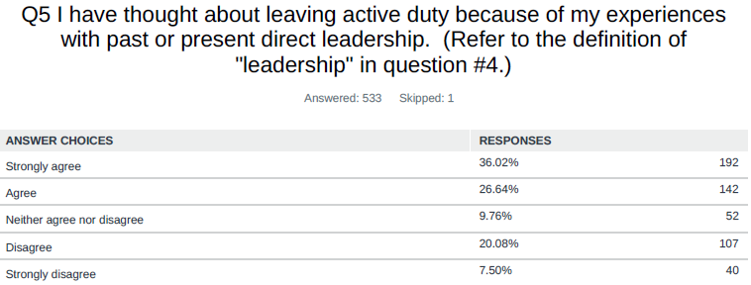
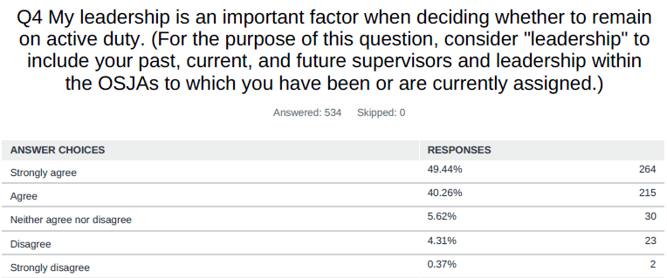
Why?
The Army takes Leadership, and leadership education/development, seriously
Leadership matters!
Notes:
It is important to note that leadership isn’t just important in our operations, but also important in the retention of Judge Advocates.
This is a survey conducted by a grad course student in 2019 studying the effect of poor leadership on subordinates’ decisions to remain in the JAGC; the survey participants were all AD MAJs (213) and CPTs (319) in the JAGC, and—for your reference—have likely experienced about 5 to 8 “direct leaders” in their careers thus far.
Leaders affect retention because great JAs have many other options besides the JAGC in terms of a career: they are thus less likely to put up with the stress a poor leader places on subordinates. This means poor leadership can affect the JAGC’s ability to retain talented attorney-officers.
That’s the bad news. The good news is: successful leadership can be LEARNED. The Army specific doctrine to assist with this education: ADP 6-22.

Slide 5
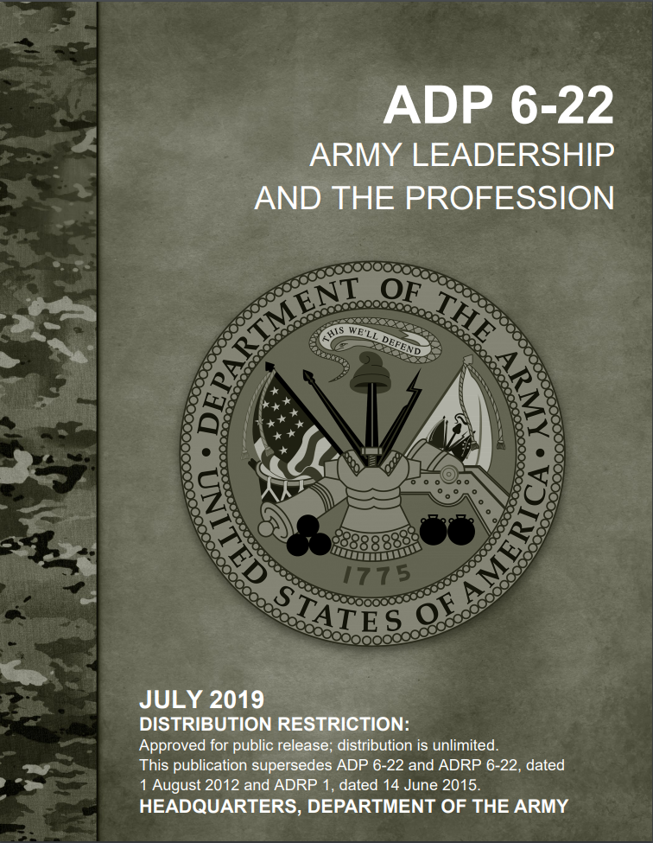
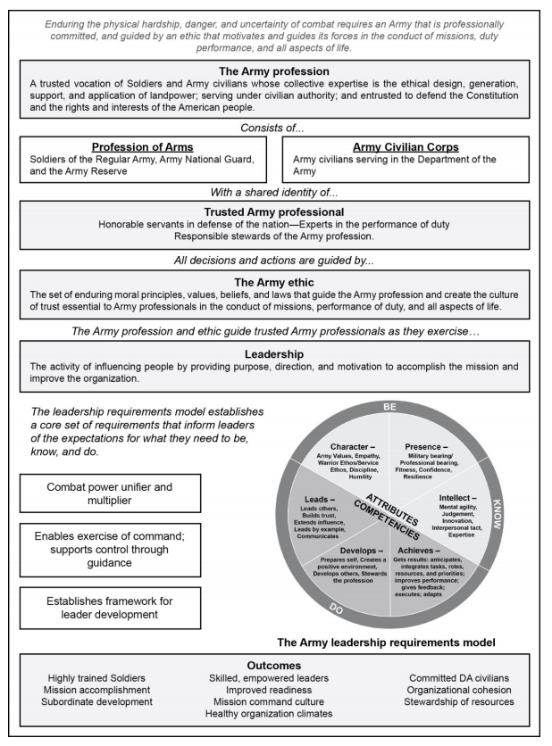
ADP 6-22, Army Leadership and the Profession
Notes:
Applies to all Army leaders all the time and
Establishes norms and expectations for all Army leaders; provides standards for evaluation
Emphasizes a trustworthy profession upon which the Nation relies
Notes that Leadership is influence
Leadership involves a wide range of behaviors and actions—it is definitely personality-dependent, but certain attributes and competencies are present in all good leaders (see LRM)
This doctrine lets us know:
Leadership can be learned and improved
The Army Profession and Ethic provide guidance to the Army professional as they exercise leadership
Leader attributes enable discretionary application of leadership
All leaders are also followers
What leaders should NOT be and do: counterproductive leadership
Need to understand the ground rules/the doctrine to apply competencies and attributes in performance appraisals, development, assessment, and counseling

Slide 6
The Army Profession
1-8. The Army Profession is a trusted vocation of Soldiers and Army Civilians whose collective expertise is the ethical design, generation, support, and application of landpower; serving under civilian authority; and entrusted to defend the Constitution and the rights and interests of the American people.
The Army Serves the Nation, The JAGC Serves the Army as a Profession
Notes:
Let’s talk about “vocation”: it’s a calling, more than just transactional work. A profession does include “doing things” (transactional work), but it also involves transformational work: building relationships, working toward a mission and vision, and garnering trust. Vocation is one’s response to a call from beyond oneself to use one’s strengths and gifts to make the world a better place through service, creativity, and leadership.
We have a shared identity with our fellow military and civilian professionals in the U.S. armed forces. This honor—tied to our oath of service—instills in all of us as sense of value, a sense of purpose, in our service.

Slide 7
Characteristics of the Army Profession
1-10. Five characteristics identify and establish the Army as a profession. These characteristics reflect American values, the Army ethic, and the Army’s approach to conducting operations. Demonstrated consistently, these characteristics reinforce trust between the Army profession and the American people. The five characteristics of the Army profession are—
Trust
Honorable service
Military expertise
Stewardship
Esprit de corps
Notes:
Ask the class which characteristic they think is the most important to possess and why. Encourage debate.

Slide 8
The Army Ethic
Notes:
What is the Army Ethic? ADP 6-22 discusses the Army Ethic and its importance in our profession and our role as leaders. Are we born with these ethics or are they learned/practiced?
Is the Army Ethic something we should think about when making decisions? Is it something that should be embedded in our decision-making and thought processes?
Let’s examine the definition of Army Ethic a bit more closely:
Set of enduring
Moral principles
Values
Beliefs
Applicable laws
Embedded within the Army culture of trust
Motivates and guides Army professionals in conducting
Mission
Performance of duty
All aspects of life
ADP 6-22 para 1-70 states, “The Army Values embody the practical application of the Army Ethic.” Simply, the Army Values move to operationalize the Army Ethic by providing 7 values Soldiers must exemplify and live by.

Slide 9
Leadership Defined
Leadership is the activity of influencing people by providing purpose, direction, and motivation to accomplish the mission and improve the organization.
An Army Leader is anyone who by virtue of assumed role or assigned responsibility inspires and influences people by providing purpose, direction, and motivation to accomplish the mission and improve the organization.
Notes:
Leadership = Influence
Your position in the military might describe you as a leader; you might have positional influence (positional power)
If you are serving in a position that is not labeled as a “leadership position” (i.e., you do not have people working directly for you), can you still gain influence? How?
Purpose, Motivation, Direction
Purpose is usually easy to provide. You have a mission, you tell people the “why” of that mission. In explaining why, provide additional context whenever time and circumstances permit. The context is important to give a full picture of the purpose. The context can also provide some level of motivation. For example, if the mission is to conduct a wet gap crossing, the “why” is we need an armored battalion across the river to engage the enemy. However, the greater context is we have Soldiers on the offer side of the river in heavy contact with the enemy and if we don’t get the armor battalion and supplies across the river they will be overran within the next 24 hours. As you can see, that gives detailed context to “why” and can have a second order effect of providing motivation.
Motivation is harder to provide. It is the will and initiative to do what is necessary to accomplish the mission. Your personality and behaviors come into play here; understanding your subordinates is important to successfully motivate them. Motivation can come through personal example. A leader who shares in the hardship and risk demonstrates they are invested in the outcome and can motivate subordinates to act. Pressure or threat of punishment can also motivate others to act. However, that form or motivation should be used sparingly as it can breed resentment and low morale.
Direction is telling others what to do. Direction requires clear communication ensuring subordinates understand the guidance. There is a balance between telling subordinates what to do and telling them how to do it. Telling them what to do without micromanaging the “how” allows subordinates the opportunity to demonstrate initiative within the overall commander's intent. General Patton said, “Never tell people how to do things. Tell them what to do and they will surprise you with their ingenuity.” So, what level of detail should you give? Does it depend on the situation? How much creativity will you allow when you give people direction? Thinking about your approach with each task and each individual is usually best.

Slide 10
Attributes & Competencies
Notes:
Let’s discuss attributes and competencies more in depth so you have an idea about (1) how to develop them better in yourselves (and those you lead) and (2) how your leaders will be assessing you in your jobs.

Slide 11
The Leadership Requirements Model (LRM)
Attributes
Character
Presence
Intellect
Competencies
Leads
Develops
Achieves
Assessment
By Your Superiors
By You
Be
Know
Do
Notes:
The LRNM is the standard by which we measure Leadership
It consist of:
-Three Attributes (things you should be and things you should know)
--Attributes encompass enduring personal characteristics which are molded through experience over time.
-Three Competencies (things you should do)
--Competencies are skills which can be trained and developed.
Your leaders will assess and evaluate you based on these six requirements (see your OER), and you should also be assessing yourselves using these attributes and competencies

Slide 12
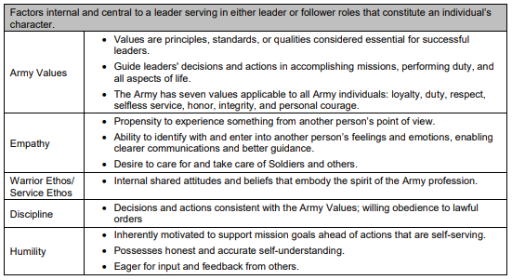
Character
Notes:
Character is a person’s “true nature guided by their conscience, which affects their moral attitudes and actions.” ADP 6-22, para. 2-1. “A leader’s personal reputation is what others view as character.” ADP 6-22 para. 2-1
If reputation is how others judge your character, what do you do if inaccurate information has been put out there that negatively impacts you reputation?
Which one of the factors used to define the attribute of character is most important? Do they build on each other?
Does empathy mean feeling sorry for someone? No. Empathy is understanding someone else’s feelings and motives. Does being empathetic lead to better communication? Why? ADP 6-22, para. 2-23
What is the Warrior Ethos? The Warrior Ethos states: I will always place the mission first; I will never accept defeat; I will never quit; I will never leave a fallen comrade. It is the “Soldier’s selfless commitment to the Nation, mission, unit and fellow Soldiers.” ADP 6-22 para. 2-26
Is discipline personal or organizational or both?

Slide 13
The Role of Humility
Humility Defined – ADP 6-22, Para. 2-31
Humility is the absence of arrogance
A person of high integrity, honesty, and character embodies the qualities of humility.
A leader with the right level of humility is a
Willing learner
Maintains accurate self-awareness (see, para. 6-15), and
Seeks out others’ input and feedback
Leaders are seen as humble when they are aware of their limitations and abilities and apply that understanding in their leadership
Humility prevents overconfidence and arrogance - ADP 6-22, Para. 3-10
Notes:
When you think “leader” do you think “humility” – why or why not?
What about self-confidence? Does humility have an impact on self-confidence? What if I have too much humility?
Too much or too little is a fine line – how do you walk it?
Asking subordinates during counselings for feedback (and then thinking about that feedback) is a good example of humility. Do not ask for feedback to simply check the block, but take the information you receive seriously and reflect on it. It will make you a better leader.

Slide 14
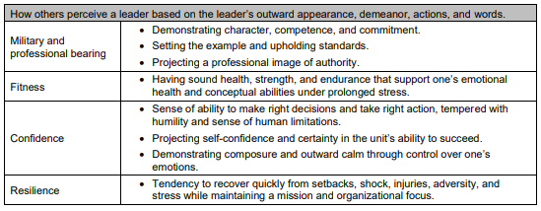
Presence
Notes:
ADP 6-22, Chapter 3
We just discussed the first attribute, character, and now we’ll move on to the second attribute, presence.
What does this matter in the military? Does it impact the advice you are giving? Probably not, but it may impact how receptive individuals are to your legal advice. If you are a leader and encourage physical fitness, but are overweight and out of shape, your subordinates are not going to take you seriously and that may have an impact on your creditability in those areas.
Is it important to have the proper uniform? Why does it matter if we are attorneys?
How does fitness and military and professional bearing impact confidence? How does confidence interplay with humility?
We hear about resiliency a lot but, what does it mean to you? How can you portray “presence” to Soldiers? I like to think of it as this simple question: when you walk into a room, what do the people in the room feel when they see you enter? If they don’t know you, do they see a fit, confident person in a great-looking uniform? That’s “layer 1” of presence. Once people get to know you, your presence (to them) might change: do they see you and think of your optimism? Your resilience? Your keen legal mind? Your kindness? That’s “layer 2” of presence.

Slide 15
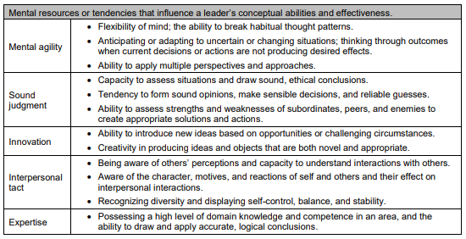
Intellect
Notes:
ADP 6-22, Chapter 4
Intellect is the third and final attribute—and it is the “Know” attribute. (The first two attributes—character and presence—are the “Be” attributes.). Intellect consists of one’s brainpower and knowledge.
Is intellect even more important for a JA than for other officers?
Think about mental agility. Have you ever been in a briefing and you have prepared your legal advice based on a set of facts, but in the meeting the set of facts changes, can you adjust? Are you able to put aside the plan you had and formulate a new plan based on the new information?
Mental agility and sound judgment are big parts in decision-making and problem-solving processes. ADP 6-22 para. 4-8. Is it sound judgement to tell a leader or commander you are unsure of the answer, but will research it and get back to them or should you be able to answer all questions on the spot? Does it depend on the type of question? Do you show subordinates it is ok to look for the answer if they’re unsure, and then get back to you? Does this also depend on the question?
Innovation – personal innovation or innovation within your leadership. It can be both. You need to be open to other individuals’, to include subordinates’, ideas. Commanders will come to you and say, ”Judge, I need to be able to do X, please find a way.” Now you should never do (or advise to do) anything illegal or unethical, but think outside the box. Is there a creative solution? Should you talk to the commander about doing Y instead of X? Also, once you include others and their ideas, they are stakeholders, which leads to increased team-building. ADP 6-22 para. 4-10.
Interpersonal tact “can be distilled down to the idea of honestly stating one’s views about an idea or other person as diplomatically as possible to ensure it is understood without causing unnecessary offense.” ADP 6-22 para 4-11. Interposal tact includes recognizing diversity and composure. ADP 6-22 para. 4-12 and 4-13. What does that mean? Diversity includes backgrounds, qualifications, experiences, and potential. ADP 6-22 para. 4-12.
Expertise is something JAs generally have (in the legal realm), but what about expertise outside the law? What is an area it might be good to have expertise in?

Slide 16
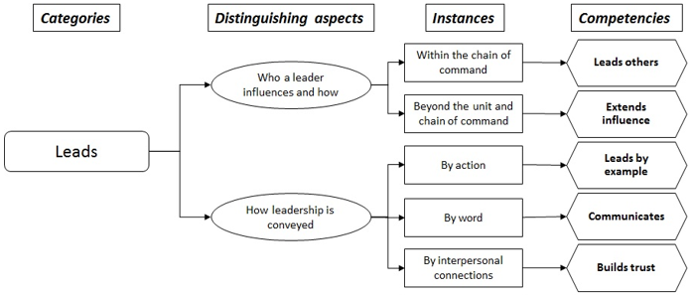
Leads
Notes:
ADP 6-22, Chapter 5
We have talked through the three attributes of character, presence, and intellect. Let’s turn now to the three competencies—the “Do” portion of the LRM.
Who is a leader, and do they influence? If so, how?
Within the chain of command
Beyond the unit and chain of command
Leads other
Extended influence
How leadership is conveyed
By action
By word
By interpersonal connections
Leads by example
Communicates
Builds Trusts
Talk through examples (without naming names).

Slide 17
Develops
Notes:
ADP 6-22, Chapter 6
The second attribute is “develops.” Think of this in terms of developing yourself and developing others/the Army. We, as attorneys, are used to developing ourselves—after years of schooling, we’ve been developing ourselves for most of our lives. The Army wants us to keep developing and pushing ourselves to learn in this organization, and, as I said, that comes naturally for most of us. However, developing others is something that is perhaps not as natural to us.
Think about how you would go about developing a subordinate:
Get to know them and their goals
Help figure out how to achieve those goals
Check in on their progress
What if you have a complacent subordinate? Or a subordinate who is not in the habit of creating, working toward, and achieving goals? You can set professional goals for the subordinate to achieve. Send them to training. Other ideas?
How do you develop the organization? Do you have to be high up to do that? The easiest way to develop an organization is to contribute to the environment (hopefully positively).
How do you create a positive environment?
-Assess the environment to make sure you understand it
-Build trust and cohesion
-Encourage Initiative
-Demonstrate care for people
-Develop esprit de corps, tradition, and history
Does this mean it is going to be nothing but good times? Does optimism, helpfulness, team spirit, etc., contribute to a positive environment?

Slide 18
Achieves
Notes:
ADP 6-22, Chapter 7
The third and final competency is “achieves.” It makes sense that this is the final competency—after leads and develops—because it refers to the end result of your efforts: you get something done, you earn something, you create something.
Is getting results always what you should be striving for? What if there are failures or obstacles, do you quit? You assess, adjust, and continue (or tweak your plan). ADP 6-22 paras. 7-11 – 7-14.
This takes planning and organization. It also means understanding the strengths and weaknesses of your subordinates and using that knowledge for mission success.
One area in “achieves” that we sometimes forget about is removing barriers. If we give a subordinate a project with a deadline and want that to be her focus, we need to work to ensure she isn’t receiving additional taskers during that time or that there aren’t any obstacles to her getting the mission accomplished. Giving subordinates the environment to conduct a successful mission is important.
Remember to share the successes. Rewarding your team and crediting them for their work is important and makes them want to continue performing.

Slide 19
What about the JAGC’s Four Constants?
Notes:
Brief overview and touch on this more in the briefing about emotional intelligence.

Slide 20
JAGC Doctrine – The Four Constants
Principled Counsel
Servant Leadership
Stewardship
Mastery of the Law
Notes:
There are four constants that we should all be focusing on and trying to improve on a daily basis. Those constants are: Principled Counsel, Stewardship, Mastery of the Law, and Servant Leadership. Each one will be discussed in the slides that follow.
Along with those constants, here are what TJAG says about them:
Servant Leadership: Know your crew (CARE)
Leaders demonstrate servant leadership when they put those they lead before themselves. A leader does this by providing purpose, direction, and motivation; they devote and commit themselves to the well-being and growth of those they serve.
Mastery of the Law: Know your craft (COMPETENCE)
In-depth knowledge, competence and skill in our practice areas. Mastery forms through experience, training, and intensive, lifelong learning and professional development. It ensures the provision of clear, timely, and accurate legal advice and counsel necessary for our client to meet present challenges, preserve legal maneuver space, and set the conditions for future victory.
Stewardship: Know your corps (COMMITMENT)
Leaders act to improve the organization beyond their own tenure. Improving the organization for the long-term is deciding and taking action to manage people or resources when the benefits may not occur during a leader’s tour of duty with an organization.
Principled Counsel: Know your client (CHARACTER)
Professional advice on law and policy grounded in the Army Ethic and enduring respect for the Rule of Law, effectively communicated with appropriate candor and moral courage, that influences informed decisions.
TJAG also refers to the four Cs when discussing the north star four constants.

Slide 21
Principled Counsel
Army Mission: To deploy, fight and win our nation’s wars by providing ready, prompt and sustained land dominance by Army forces across the full spectrum of conflict as part of the joint force.
Army Leadership
Legal Leadership
JAGC Mission: Provide principled counsel and premier legal services, as committed members and leaders in the legal and Army professions, in support of a ready, globally responsive, and regionally engaged Army.
Dual Professionals
Principled Counsel is professional advice on law and policy grounded in the Army Ethic and enduring respect for the Rule of Law, effectively communicated with appropriate candor and moral courage, that influences informed decisions.
Leadership - the activity of influencing people by providing purpose (the reason to achieve a desired outcome), direction (telling others what to do to accomplish the mission: prioritizing tasks, assigning responsibility, supervising, and ensuring subordinates perform to standard), and motivation (the will and initiative to do what is necessary) to accomplish the mission and improve the organization. ADP 6-22
Notes:
As dual professionals, the JAG Corps combines Army Leadership and Legal Leadership paradigms.
Professional – expert, researched, timely, relevant, accurate, and zealous
Law and Policy – counsel is more than just the law; best practice is to distinguish legal advice from policy advice
Effective Communication – clear and succinct content delivered with appropriate means, composure, and interpersonal tact that creates a shared understanding
Composure – emotional self-control, balance, and stability
Interpersonal Tact – understanding the character, reactions, and motives of oneself and others; should be balanced by professional candor
Candor – saying what needs to be said or done for the good of the mission or the unit
Moral Courage – the willingness to stand firm on values, principles, and convictions including carefully considered professional judgment offered to subordinates, peers, and superiors
Informed Decisions – sound judgment that balances facts, questions assumptions, compares courses of action, and considers consequences
Principled counsel should inform a commander's exercise of discretion and is not intended to obstruct a commander's intent.

Slide 22
Questions?
Leadership Center Website
Leadership Center - The Judge Advocate General's Legal Center & School - TJAGLCS (army.mil)
Leadership Center Mailbox
usarmy.charlottesville.hqda-tjaglcs.mbx.leadership-center@army.mil

