Slide 1
Counterproductive Leadership

Slide 2
Agenda
Introduction
Leadership Requirements Model (LRM)
Doctrine
Discussion
Questions
Notes:
Today we will be talking about Counterproductive leadership (what it is, how to identify it, and how to address it)
Counterproductive leadership behaviors can destroy morale, deplete productivity, breed distrust, and ultimately lead to mission failure

Slide 3
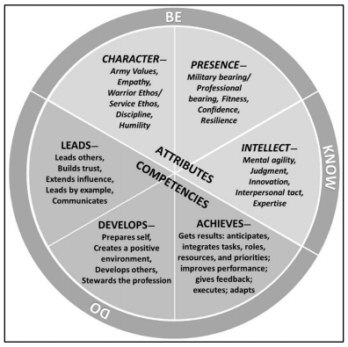
Leadership Requirements Model
The Army expects all leaders to live the Army Values and demonstrate the positive characteristics described by the leader attributes and core leader competencies.
ADP 6-22, para. 8-45

Slide 4
Leadership Requirements Model
Counterproductive leadership is the demonstration of leader behaviors that violate one or more of the Army’s core leader competencies or Army Values, preventing a climate conducive to mission accomplishment. ADP 6-22, para. 8-46
Toxic?
Notes:
Toxic behaviors are now considered counterproductive
Concern that the Toxic typically attached to the person, NOT the behavior and the adverse impact on the team

Slide 5
Counterproductive Leadership
All leaders are susceptible to displaying counterproductive leadership behaviors in times of stress, high operational tempo, or other chaotic conditions to achieve short-term results. . . . Army leaders can and will make mistakes, so distinguishing between occasional errors of judgment and counterproductive behavior is important.
ADP 6-22, paras. 8-47 & 48.

Slide 6
Counterproductive Leadership Attributes
Abusive behaviors
Self-serving behaviors
Erratic behaviors
Leadership incompetence
Corrupt behaviors

Slide 7
Abusive Behaviors
Condescending behavior
Bullying
Berating others for mistakes
Creating conflict
Ridiculing others because of the authority held
Domineering
Showing no respect for others
Retaliating for perceived slights

Slide 8
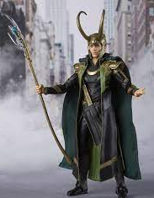
Self Serving Behaviors
Self-centered motivations
Seek primarily to accomplish own goals
Arrogance
Lack of concern or empathy
Taking credit for others’ work
Insisting on having their way
Exaggerating accomplishments
Putting own work ahead of others / mission
Sense of entitlement
Narcissistic tendencies
Notes:
The “all about me” leader
Classic Bathsheba syndrome
Focused on how he looks up the chain, but NOT with peers/subordinates
Takes credit for others work

Slide 9
Erratic Behaviors
Poor self-control or volatility – erratic or unpredictable acts
Blaming others
Deflecting responsibility
Losing temper at the lightest provocation
Behaving inconsistently in words and actions
Insecurity
Being unapproachable

Slide 10
Leadership Incompetence
Lack of experience or willful neglect
Failure to act or acting poorly
Often associated with arrogant or abusive leaders who are not self-aware – do not seek to correct their shortcomings
Can also be associated with leaders who are aware of their shortcomings – seek to cover up their shortcomings
Unengaged leadership
Passive or reactionary
Neglect leadership responsibilities
Display poor judgment
Poorly motivates others
Withholds encouragement
Fails to communicate expectations
Refuses to listen to subordinates

Slide 11
Corrupt Behaviors
Violating explicit Army Standards, regulations, or policies
Dishonesty
Misusing government resources or time
Creating a hostile work environment
EEO/SHARP violations
Requirement of Exemplary Conduct – 10 USC 3583
UCMJ

Slide 12
Discussion
How many of you have worked for a counterproductive leader?
What impact does the counterproductive leader have on the organization?
What are the best ways to deal with a counterproductive leader?
Do you recognize counterproductive traits in yourself?

Slide 13
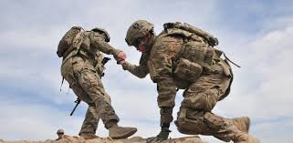
Countermeasures
How will I lower the risk of counterproductive leadership?
Detection
Identification
Action
Notes:
Detect the behavior
Identify an appropriate countermeasure
Take Action

Slide 14
Developing Countermeasures
How do you minimize negative effects of counterproductive leadership?
What countermeasure might you use?
Notes:
Direct approach…easy concept in the class room…but sometimes not so easy to address practically
Being deliberate about what, how, and why we do things…
Asking questions …especially when you are new
Talking to your teams, know the culture
Being present! As a leader, you will not always see everything that goes on at the level of execution
BUT…How do you respond to more senior leader (Rank, Position, Old dog/new tricks)
Command Chain…Everyone has a boss!
Third file – Reputation matters. How you treat others matters. Leaders see more than you might think!

Slide 15
Productive Leadership
As the Army moves into increasingly more complex operational environments, it is critical that leaders rely on positive behaviors to influence others and achieve results. . . . All leaders are susceptible to counterproductive behaviors, so they must monitor their personal behavior.
ADP 6-22, para. 8-50.
Notes:
We often think of counterproductive behaviors as they exist with other people…
What about you?

Slide 16
Humility
A leader with the right level of humility is a willing learner, maintains accurate self-awareness, and seeks out others’ input and feedback. Leaders are seen as humble when they are aware of their limitations and abilities and apply that understanding in their leadership. -- ADP 6-22, para. 2-31
The more powerful you get, the more likely you are to believe your ego, which leads to false beliefs and hubris. . . . Humility is the antidote to hubris. - GEN Mark Milley, CSA, 3 May 2017
Notes:
For you and subordinates – AWARENESS
We can choose to seek this out and we can develop this ourselves….but you can’t force humility on others
OSJA advantage --Leadership Foundation – (what else do we have?)

Slide 17
Questions?
Leadership Center Website
Leadership Center - The Judge Advocate General's Legal Center & School - TJAGLCS (army.mil)
Leadership Center Mailbox
usarmy.charlottesville.hqda-tjaglcs.mbx.leadership-center@army.mil

