Slide 1
Opening Remarks

Slide 2
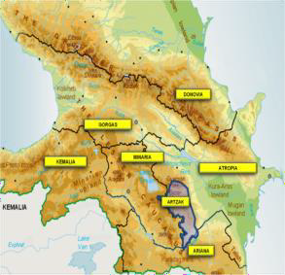
What is a Warfighter?
Warfighter is a tailorable, scalable, simulation-based capstone training event for Divisions and Corps,
exercising Large Scale Combat Operations against a peer, free-thinking opposition force
Leverages technology to exercise and certify Division and Corps formations
Challenges the U.S. and partners to deploy into an expeditionary fight and to solve challenges like:
Interoperability – Human, Technological, and Procedural
Political considerations – Transitioning between kinetic operations and stability operations
Contested airspace
Peer, free thinking and unscripted threats
Cyber, Information, Electromagnetic threats
Logistics
Provides the commander and the Army with real-time feedback
through observation, embedded mentors, after-action reviews, and
lessons learned
Integrates Army Battle Command Systems (C4I: Command, Control,
Communication, Computers & Intelligence)
Incorporates real world Command Nodes in field or garrison simulating
static/mobile, at sea, or over the horizon capabilities
Includes ESC, BDEs (Functional, Multi-Functional) in various command relationships

Slide 3
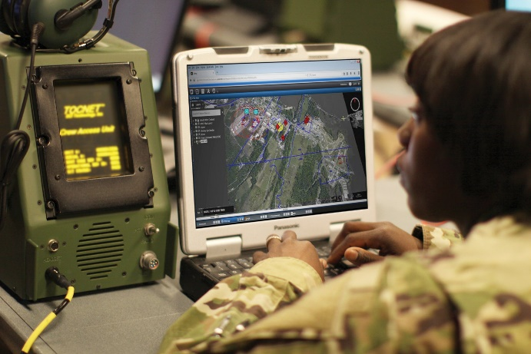
Who are we?
MCTP OC/Ts facilitate mission command training through 24-hour coverage for unit command groups, staff, and key leaders in their respective command posts, as well as staff/warfighting function and integrating cells throughout the WFX. TR350-50-3
Religious Support Observers, Coaches & Trainers aligned against 3 Operations Groups (Alpha, Bravo, Charlie)
The role of the MCTP OC/T:
Help you see yourself – ask lots of questions
Learn from you as we share our experiences
Know doctrine, understand Division and Corps operations
Do not act as a higher command, adversaries, or sharpshoot you
It is your exercise – own it, we are an outside observer
Provide as many touchpoints, trainings, product review as you want or need
Striking the right balance of presence, observation, coaching, and absence
MCTP OC/T mission is the support of Divisions, Corps, & ASCCs – we are happy to work with BDEs, but we will ask first
Coordinate closely with 1st Army during training events with National Guard
Publishes papers, articles, briefings, and provide training on request

Slide 4
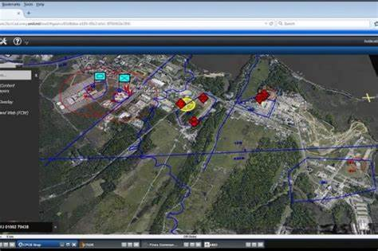
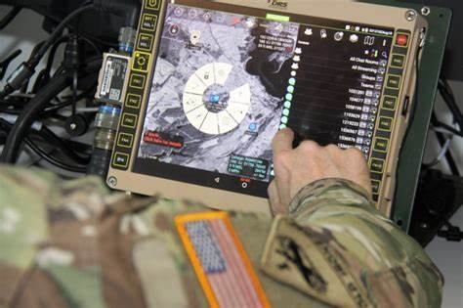
How to Win a WFX
Start Early
It is about your products
Identify your Top 3 Priorities
Match your Commander’s energy
Don’t prepare for WFX, prepare for War
Be open to learning
Use as leader development
Make mistakes when the stakes are low
Have fun! Don’t be the mad Chaplain in the tent
Approach
Attitude
Corps fights the Corps fight; Division fights the Division fight
Do not do the BDE’s work
Know the RSP 2 levels up
Know who is who in the zoo
Know your Echelon / Roles / Relationships

Slide 5
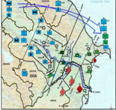
25 Keys to Success
READ DOCTRINE
ADVISE YOUR CO
AND STAFF
DETERMINE DECISION POINTS
&
IMPLAMENTATION PROCESS
BUILD RELATIONSHIPS
CALL YOUR MOM
SHE MISSES YOU
IDENTIFY & CODIFY
BATTLE DRILLS
PRODUCE PLANNING &
GUIDANCE PRODUCTS
KNOW CURRENT OPERATIONAL
CONSTRUCT (MDO)
BUILD TEAMS
PROTECT TIME TO
TRAIN WARTIME SKILLS
TRAIN AGAINST
SKILL DEFICIENCIES
UNDERSTAND THE
FIGHT BY ECHELON
DIGITAL/ANALOG PRODUCTS
TO VISUALIZE THE AO
REHEARSALS
PARTICIPATE IN MDMP &
INTEGRATE INTO STAFF
LEARN HOW YOUR
STAFF WORKS
PRODUCE FIGHTING PRODUCTS
READ HISTORY ON
THE ASSIGNED AREA
THINK SURVIVABILITY &
REDUNDANCY
RSO&I / ECCLESIASTICAL LOGISTICS
PERSONNEL LOCATION
BY CP & AUTHROITIES MATRIX
HAVE FUN
CARE FOR YOUR SOUL &
THE SOULS OF YOUR TEAM
LEARN TO USE
DIGITAL SYSTEMS
DON’T STAY TOO LATE
Notes:
Read doctrine
Read history and about the geographical location of potential places of conflict
Keep abreast of the latest thinking in warfighting, how we fight and how our enemies fight
Care for your soul and those of your team members; gird yourself for arduous fighting, long days, and ministering in time of death and destruction
Work on planning and guidance products (RS TACSOP, Tab D, etc.)
Work on fighting products (battle roster, COP / Running Estimate format, etc.)
Identify and codify key battle drills
Rehearse and practice: battle drills, communication, battle rhythm
Determine who will be in what command post, and who has decision authority in what areas
Learn about replacement process and the logistics of religious support supplies
Determine both digital and analog ways to visualize, display, and communicate
Consider what types of decisions the chaplain will need to make and what types of processes need to be put in place to support those decisions
Identify what fights are at what level (BDE, DIV, Corps, Theater)
Identify deficiencies in skills, make a plan to train those skills, and train them
Learn how to use communication systems and platforms;
Be engaged in MDMP and other group staff processes
Build Relationships: commander; staff; chaplain section; subordinate UMTs; higher echelon; adjacent echelons
Build Teams: chaplain section; UMTs; division and corps staff
Learn how the staff works, who does what, who the iron majors are, and how staff processes work
Determine roles of members of the chaplain section; build redundancy
Consider what “advise the command” looks like at this level: what to advise on; how to gather the wisdom and information to advise; the best way to advise a busy GO commander
Set aside time each week to focus on warfighting skills and goals; protect the time from the tyranny of the urgent, ankle biters, and ever-present garrison matters
Have fun, enjoy the process, learn stuff
Don’t stay in the office too late, your family needs you
Call your mom, she misses you

Slide 6
Trends / Observations / Lessons
WFX 22-2 Korea Scenario
Communication to subordinates and adjacent CPs
Visualizing the RS plan within the staff section
Creating shared understanding across echelons
WFX 22-4 Baltic Scenario
Communication to subordinates
Synchronization of RS Plans by echelon (theater to corps)
Manning – Unable to integrate CD-C into exercise
WFX 23-1 Pacific Scenario
Planning & preparation activities prior to WFX
Developing shared understanding - Corps to Division
Non-TA Chaplain involvement – Leader Development
WFX 23-2 Baltic Scenario
Planning & preparation activities prior to WFX
Staff integration and development of OPS understanding
Assessment and refinement of products, processes and tools

Slide 7
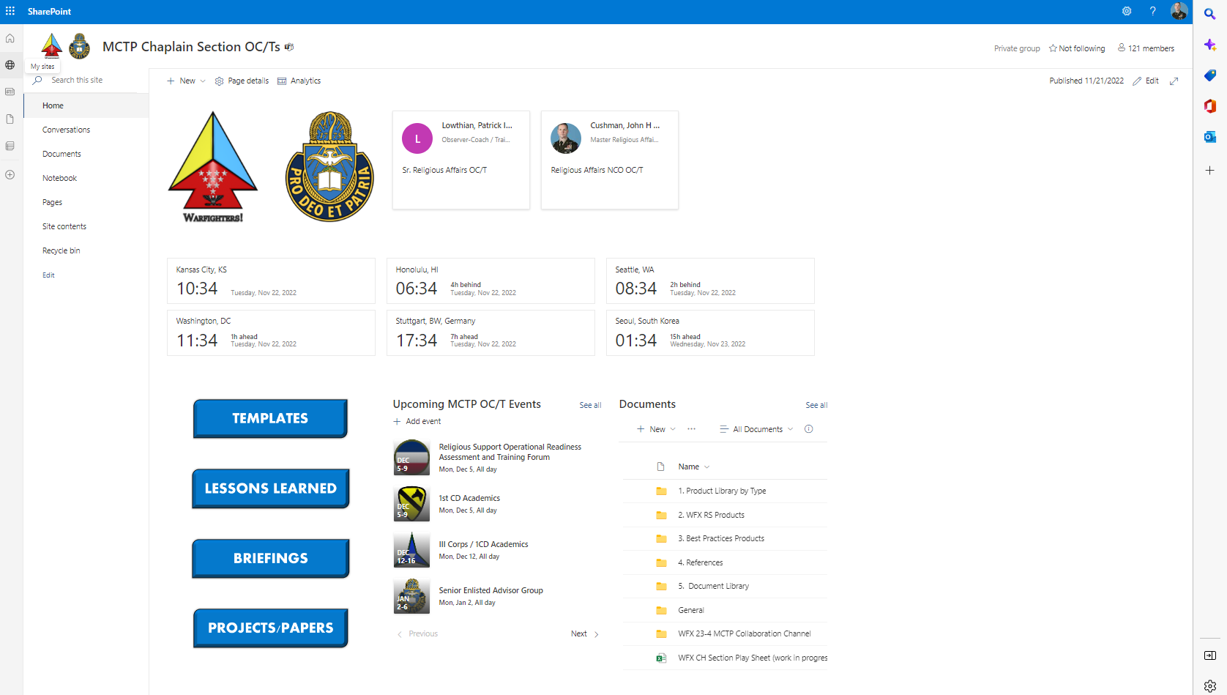
Let Us Help You

