Slide 1
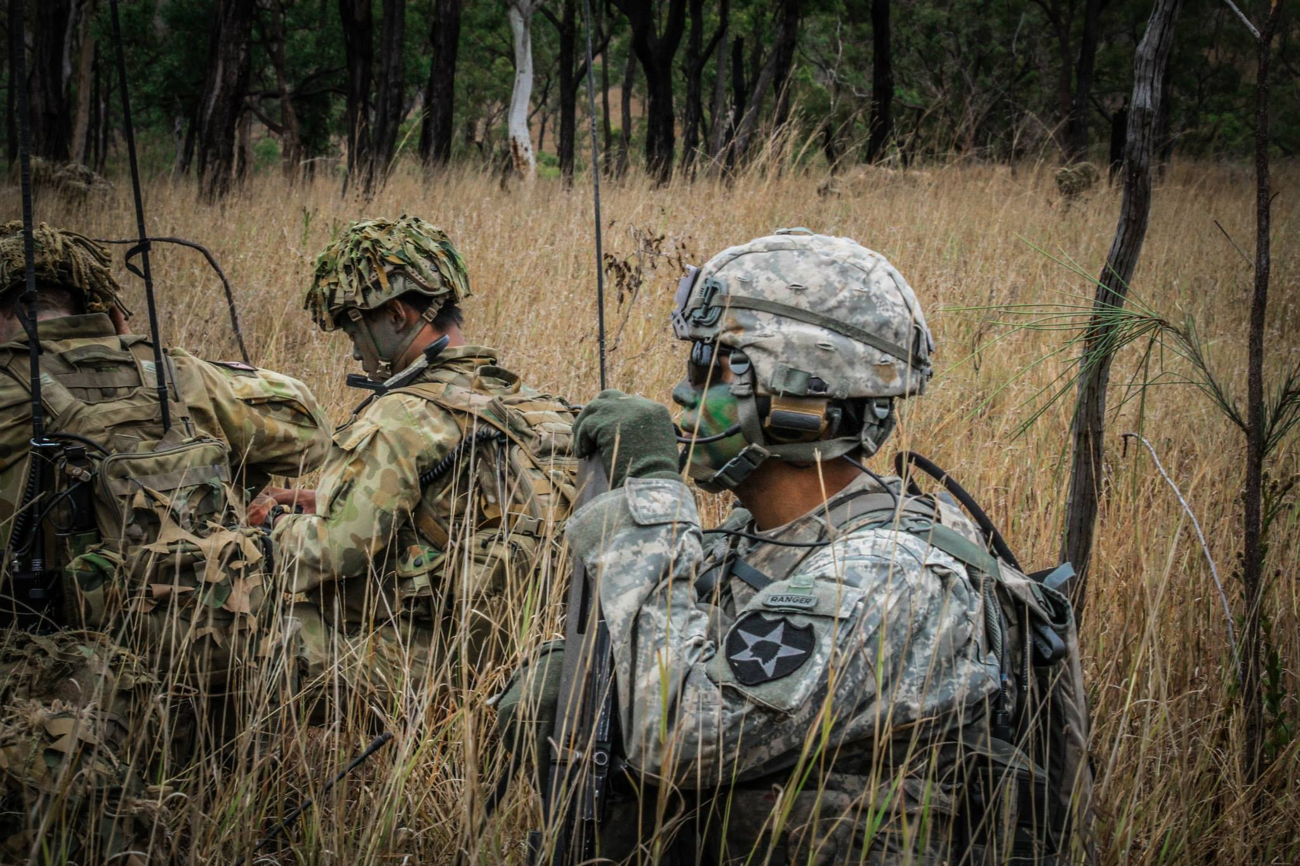

UNCLASSIFIED//CUI
As of 30 NOV 2022
United States Army Pacific
OCCH Strategic Brief
Command Chaplain
CH (COL) Gary T. Fisher
Chief Religious Affairs NCO
SGM Joe E. Stanfield Jr.
One Team!
America’s Theater Army in the Indo-Pacific
Provide the Joint Force with the decisive landpower needed to
Compete, Fight, and Win.

Slide 2






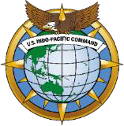
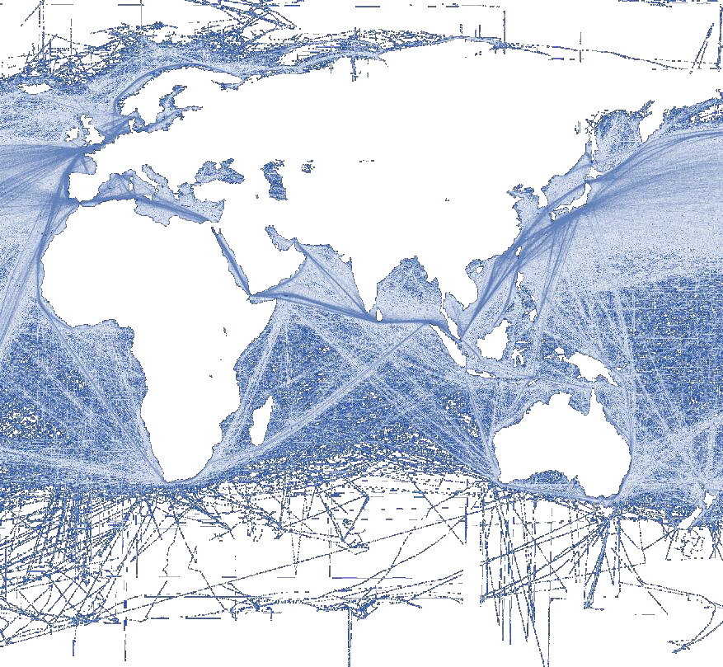
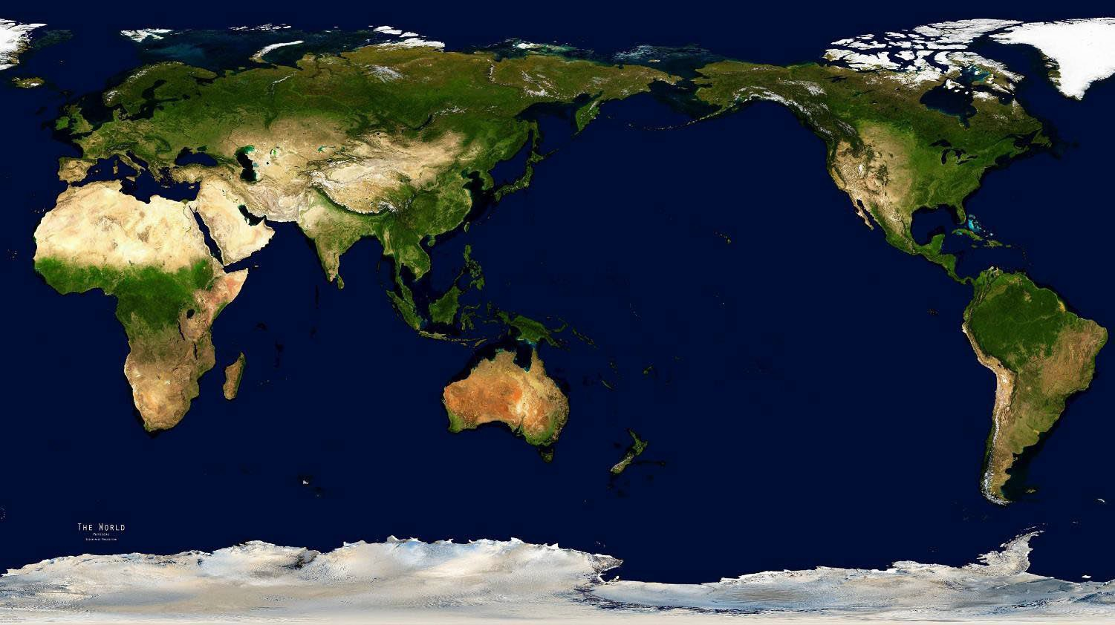

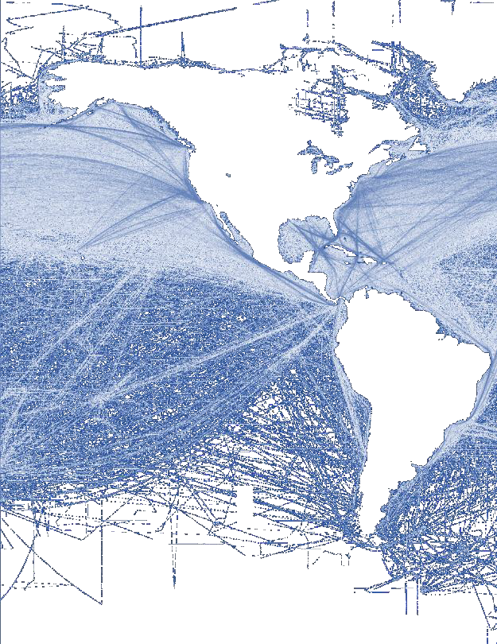

The Most Complex and Consequential Region - INDOPACOM
UNCLASSIFIED
4 billion people
~2 billion connected to cyber domain
24 of 36 global megacities (population 10M+)
70% of global population by 2050
7 of 10 largest militaries in the world
22 of 30 Chiefs of Defense are Army Officers
UNCLASSIFIED
FDO: USARPAC-NOV22-001
Notes:
Presenter
2022-07-26 08:19:12
--------------------------------------------
Source: Open source

Slide 3

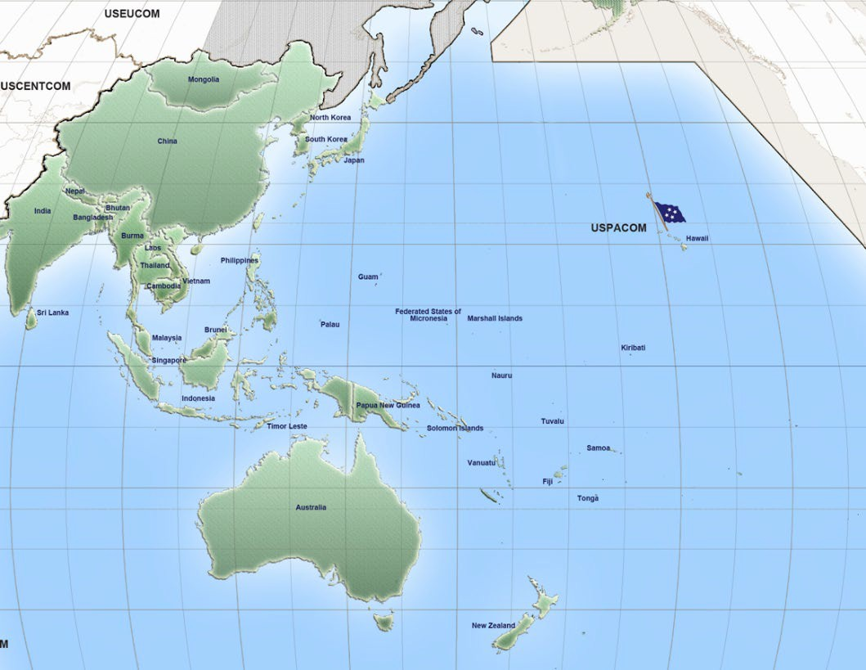



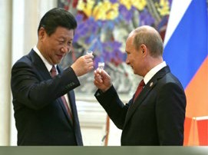
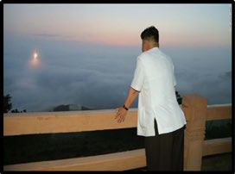


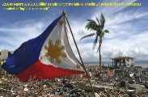


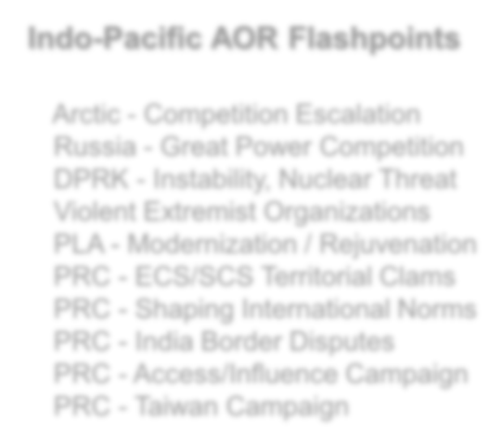




USARPAC – Threat Environment
UNCLASSIFIED
2
1
3
7
8
5
6
10
4
6
4
9
9
4
Indo-Pacific AOR Flashpoints
Arctic - Competition Escalation
Russia - Great Power Competition
DPRK - Instability, Nuclear Threat
Violent Extremist Organizations
PLA - Modernization / Rejuvenation
PRC - ECS/SCS Territorial Clams
PRC - Shaping International Norms
PRC - India Border Disputes
PRC - Access/Influence Campaign PRC - Taiwan Campaign
10
UNCLASSIFIED
FDO: USARPAC-NOV22-001
3

Slide 4
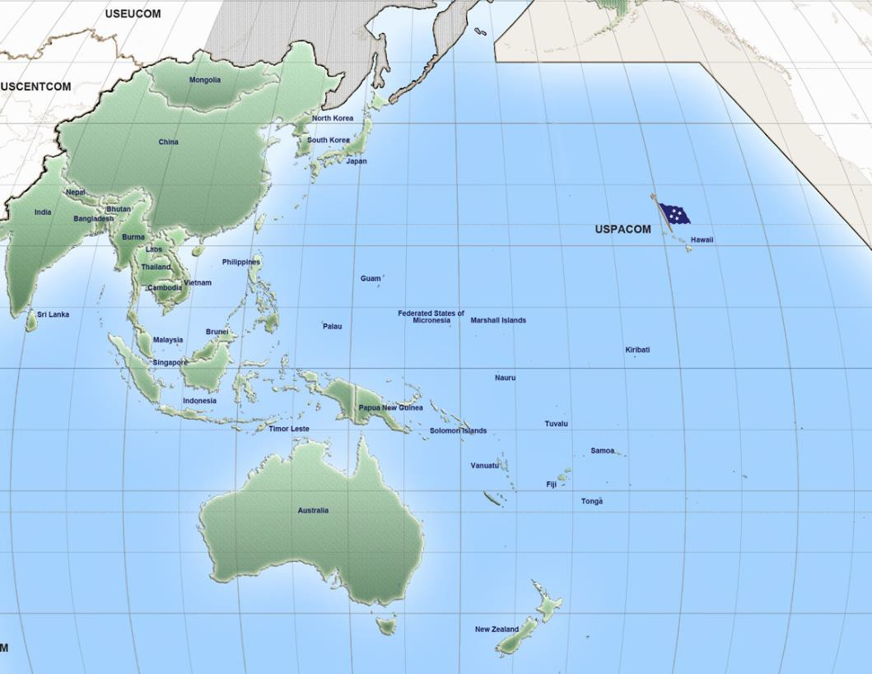







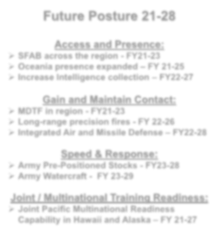










USARPAC – Theater Army Future
CUI//REL TO USA, DEU, FVEY, KOR
2
1
7
3
Northeast Asia
8
5
6
10
4
South Asia
Future Posture 21-28
9
6
4
9
Access and Presence:
SFAB across the region - FY21-23
Oceania presence expanded – FY 21-25
Increase Intelligence collection – FY22-27
4
Southeast Asia
Gain and Maintain Contact:
MDTF in region - FY21-23
Long-range precision fires - FY 22-26
Integrated Air and Missile Defense – FY22-28
Oceania
Speed & Response:
Army Pre-Positioned Stocks - FY23-28
Army Watercraft - FY 23-29
Joint / Multinational Training Readiness:
Joint Pacific Multinational Readiness Capability in Hawaii and Alaska – FY 21-27
Deterrence = Capability + Posture + Will + Signaling
CUI//REL TO USA, DEU, FVEY, KOR
FDO: USARPAC-NOV22-001 4

Slide 5




























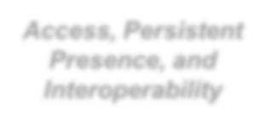

















USARPAC – The Theater Army
Alaska
CUI//REL TO USA
11th ABN Div
, DEU, FVEY, KOR
US Army Alaska
Korea
Japan
U.S. Army Japan
Alaska ARNG
Eighth Army
Washington
I Corps Fwd
I Corps
2d ID
Power Projection
593rd ESC
19th ESC
Forward Postured
1st MDTF
Guam
Guam ARNG
5th SFAB
Access, Persistent Presence, and Interoperability
California
351st Civil Affairs
(USAR)
State Partnerships with Bilateral Affairs Officer
Hawaii
Year Established / Partnerships 2003 / Alaska – Mongolia
2000 / Guam & Hawaii – Philippines 2006 / Hawaii – Indonesia
2009 / Idaho – Cambodia (Dormant)* 2008 / Oregon – Bangladesh
2012 / Oregon – Vietnam
2014 / Nevada – Tonga (Shared BAO with Fiji) 2002 / Washington – Thailand
2017 / Washington – Malaysia 2019 / Nevada – Fiji
2019 / Utah – Nepal
2020 / Montana – Sri Lanka
2020 / Wisconsin – Papua New Guinea 2020 / Rhode Island – Timor- Leste 2021 / Montana - Maldives
U.S. Army Pacific
9th
(US
Msn Spt Cmd AR)
25th ID | 8th TSC | 18th MEDCOM
Hawaii ARNG | 94th AAMDC | 311th SIG Cmd
USACE-POD | 9th Msn Spt Cmd (USAR) | IMCOM-P
Providing Decisive Landpower to the Joint Force!
CUI//REL TO USA, DEU, FVEY, KOR
FDO: USARPAC-NOV22-001
5

Slide 6

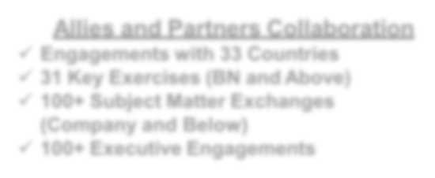



















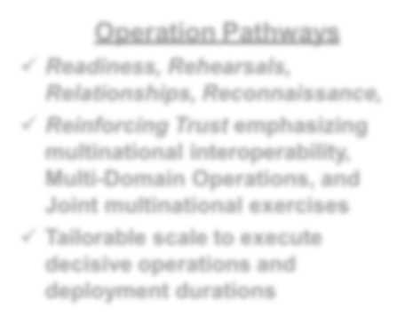




USARPAC – Exercises
CUI//REL TO USA, DEU, FVEY, KOR
Allies and Partners Collaboration
Engagements with 33 Countries
✓ 31 Key Exercises (BN and Above)
Mongolia Khaan Quest
100+ Subject Matter Exchanges (Company and Below)
100+ Executive Engagements
Japan
Keen Edge (Even) Keen Sword (Odd)
Yama Sakura Orient Shield
South Korea CCPT 1&2
Freedom Passage
Bangladesh Tiger Lightning
India
Yudh Abhyas
Hawaii RIMPAC
Pacific Sentry Pacific Fury
Alaska Northern Edge
Thailand Cobra Gold
Vietnam SMEE
Hanuman Guardian
Philippines Balikatan Salaknib
Malaysia Kerris Trike
Bersama Warrior
Brunei
Pahlawan Warrior
Guam
Valiant Shield
Maldives SMEE
Singapore Tiger Balm Lightning Strike
Indonesia Garuda Shield Gema Bhakti
Operation Pathways
Readiness, Rehearsals, Relationships, Reconnaissance,
Australia Talisman Saber Hamel
Fiji Cartwheel
Reinforcing Trust emphasizing multinational interoperability, Multi-Domain Operations, and Joint multinational exercises
Tailorable scale to execute decisive operations and deployment durations
New Caledonia Croix du Sud
Synchronized efforts achieving Trust, Interoperability, and Presence
CUI//REL TO USA, DEU, FVEY, KOR
FDO: USARPAC-NOV22-001 6
Notes:
Presenter
2022-07-26 08:19:21
--------------------------------------------
Source: USARPAC Commander’s Vision and Intent

Slide 7



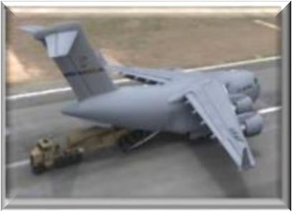

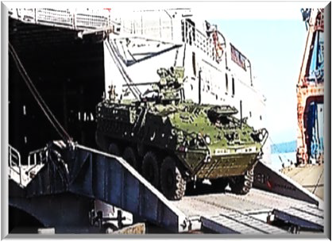

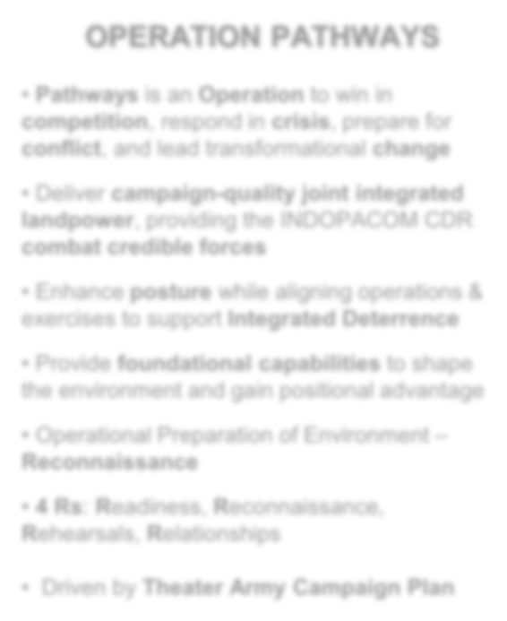

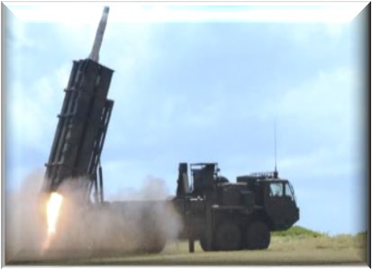



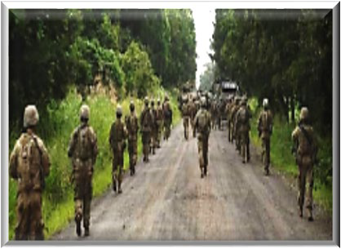
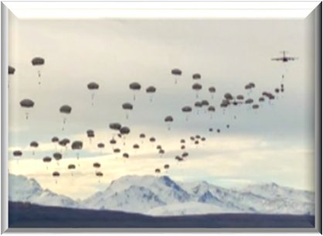

USARPAC – Operations: Pathways
CUI//REL TO USA, DEU, FVEY, KOR
OPERATION PATHWAYS
Pathways is an Operation to win in competition, respond in crisis, prepare for conflict, and lead transformational change
Deliver campaign-quality joint integrated landpower, providing the INDOPACOM CDR combat credible forces
Enhance posture while aligning operations & exercises to support Integrated Deterrence
Provide foundational capabilities to shape the environment and gain positional advantage
Operational Preparation of Environment –
Reconnaissance
4 Rs: Readiness, Reconnaissance, Rehearsals, Relationships
Driven by Theater Army Campaign Plan
Strategic Deployment
Operational Maneuver & Sustainment
Long Range Precision Fires & Maritime Strike
CUI//REL TO USA, DEU, FVEY, KOR
FDO: USARPAC-NOV22-001
7

Slide 8

What the Pacific Theater Requires. . .
UNCLASSIFIED
Strategic – Theater Army, USARPAC
- See, Sense & Understand – Strategic Foresight
- Set the Theater – Mortuary, Medical & Logistics
- Prioritized Personnel Placement – Pacific Experience
Operational – Corps and Divisions
- Build Competency
- Synchronize Integrated RS at Echelon
- Balance Direct RS & Advisement
- Multi-Node Command & Control
Tactical – Brigade and Battalion
- Build Capability & Capacity
- Nurture, Care & Honor
- Self Sustaining UMT/RST’s
- Jungle Field Craft
UNCLASSIFIED
FDO: USARPAC-NOV 22-001
8

